Slide 1
Tunu NODE DIY ACTIVITIES FOR Q2 2024
Njoku Hyginus E

Slide 2
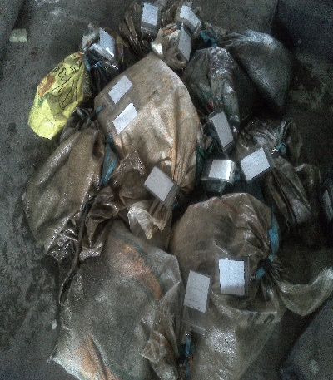
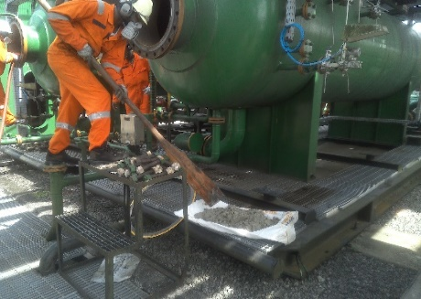
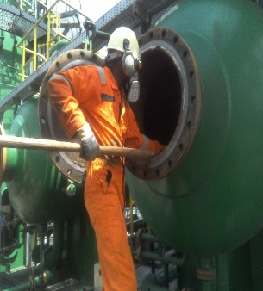
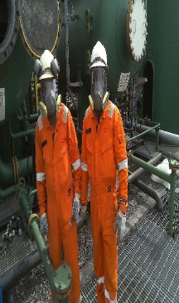
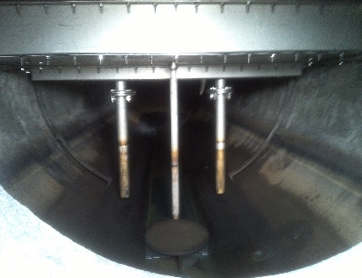
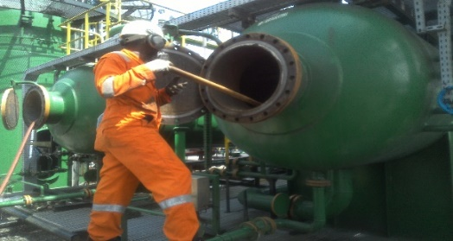
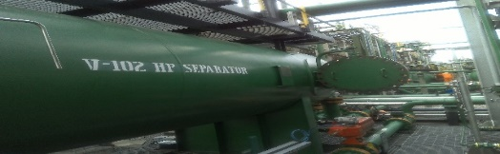
VESSEL DESANDING ACTIVITIES IN TUNE NODE FACILITIES
PROBLEM STATEMENT :
Tunu Node flow station vessel desanding are being carried out as per SAP maintenance plan.
ACTIVITIES:
Vessel de-sanding across Tunu Node facilities are been undertaken by the in-house personnel. The team Planned, secured materials, tools and consumables required for efficient and safe exercise within the time frame. During April 2024 TAM, the team collaborated as usual, and safely executed vessel de-sanding activities of crude oil separators, vessels, crude oil export pump suction piping header and oil saver pit across the four flow stations in the node.
The following quantities of sand were recovered from vessels as follows:
Tunu F/S: Test sep1 - 43.8kg, HP1- 52.3kg, HP2- 61.1kg, LP 1-41.8kg, LP2- 32.60 kg, SV1- 208.95kg, SV2- 101.80 Kg, Crude Oil Pump Suction Header- kg).Total sand recovered = 542.35kg.
Ogbotobo F/S: LP-15kg, HP- 72kg, Test sep-18kg & SV- 2kg). Total sand recovered = 107 kg.
Beniesede F/S: LP1-1KG, LP2-16.85KG, LP3=0KG, HP=2KG, SV1=0KG, SV2=0KG and SAVER PIT=100KG. Total sand recovered =142.75kg.
Opukushi F/S: HP1-14.7kg, HP2-0.7kg, LP1- 2.0kg , LP2- 21.8kg, Test Sep1- 2.10kg, SV3- 4.0kg and Saver Pit is 21.0kg = Total sand recovered 66.30kg.
The recovered sand were sent to FOT for treatment and disposal while samples of the sand production was also taken to lab for NORM and scaling sample analysis.
COST SAVINGS:
Cost saving on the Manpower if a contractor were to execute the activity with the number of separators, vessels, saver pits and oil export pump header piping's across the 4-stations in the node- (COST saved $38,616.42).
Typical Sand recovered during the vessels
Men at works
Typical vessel on completion of desanding and flushing.

